Slide 1
Fall 2023 Semester MBA Advising
Tips, Tricks, and Tools

Slide 2
Question # 1… What should I take?
MBA Program of Study
Program of Study “formula”
36-42 Units
X Foundational Core (FC) + 20 Professional Core (PC) + Y Electives (E) + 1 or 3 Culminating Experience (CE) = 36-42
Electives = 9 to 15 units depending on Foundational Core
Each Student has a POS between 36-42

Slide 3
Examples of the MBA POS Formula
10 FC + 20 PC + 9 E + 1 or 3 CE = 40-42
8 FC + 20 PC + 9 E + 1 or 3 CE = 38-40
5 FC + 20 PC + 9 E + 1 or 3 CE = 35-37
5 FC + 20 PC + 12 E + 1 or 3 CE = 38-40
2 FC + 20 PC + 15 E + 1 or 3 CE = 38-40
0 FC + 20 PC + 15 E + 1 or 3 CE = 36-38
6-10 Foundational Core = 9 Electives
3-5 Foundational Core = 12 Electives
0-2 Foundational Core = 15 Electives

Slide 4
What Classes Do I Take First?
Rule of Thumb: Start with Foundational (if needed), then Professional, then Electives. Your Culminating Experience should be taken in your last semester.
BA 640-BA 645
BA 649-BA 676
Electives: ACCTG, BA, FIN, MGT, MIS, MKTG
BA 795
Pay attention to pre-requisites! (I will cover this later!)

Slide 5
Foundational Core (When/How they are offered)
Course “Pairs”
BA 640 (Financial Reporting and Analysis) and BA 643 (Managerial Economics)
BA 642 (Statistics) and BA 644 (Operations and Supply Chain Management)
Class 1: 8 in person + 2 asynch meetings; Class 2: 7 in person + 3 asynch meetings
Course 1 1&2 | W1 | W2 | W3 | W4 | W5 | W6 | W7 | W8 | W9 | W10 | W11 | W12 | W13 | W14 | W15 | FIN
 | Course 1: First session takes place Week 1 |  |  |  |  |  |  |  | Final Assessment in Week 15
 | Course 2: First session takes place Week 2 |  |  |  |  |  |  |  | Final Assessment in the finals week.

Slide 6
Electives (when the time comes…)
Electives can be taken from any ACCTG, FIN, MGT, MIS, and MKTG graduate class.
Suggested Electives on website is not a full-list! Need to review what is offered every semester.
Up to six units in BA 780, Field Studies in Business and BA 798, Special Studies.
Up to six units of 500 level coursework can be included.
Up to six units can be taken from outside of the Fowler College of Business upon approval by the director of graduate business programs.
Specializations are OPTIONAL!
Finance
Health Services Admin.
Information Systems (STEM)

Slide 7
Part-time or Full-time
Working full-time or other full-time commitment -> Part-time
Working 20 hours or less -> Full-time
It’s all up to you! (But remember you need to maintain a 3.0!)

Slide 8
Question #2… How do I register?
Understanding the schedule
My.SDSU
Waitlist

Slide 9
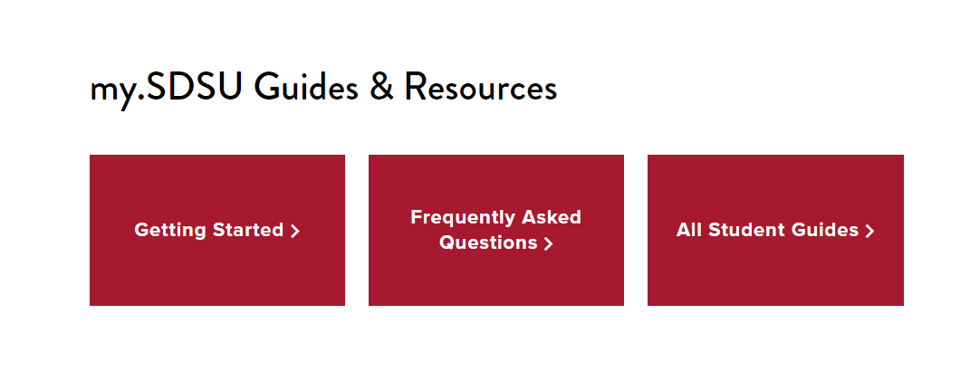
Getting Started: My.SDSU
my.sdsu.edu/students

Slide 10
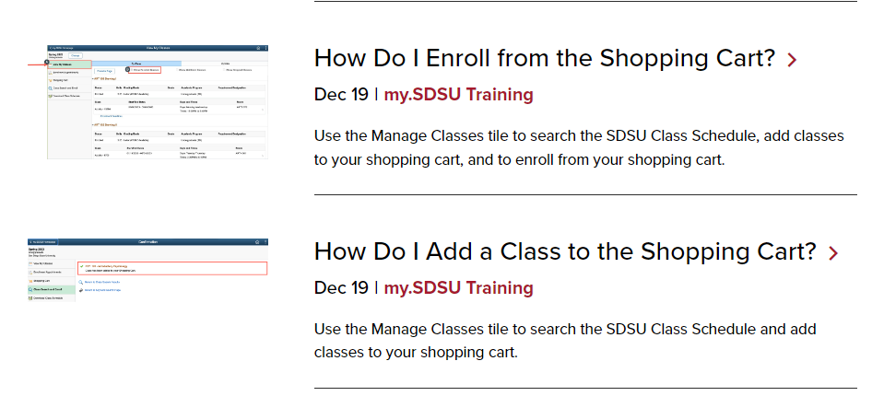
Use student guides

Slide 11
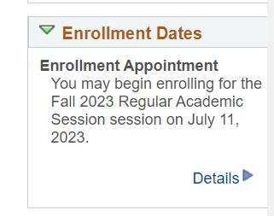
Enrollment Appointment

Slide 12
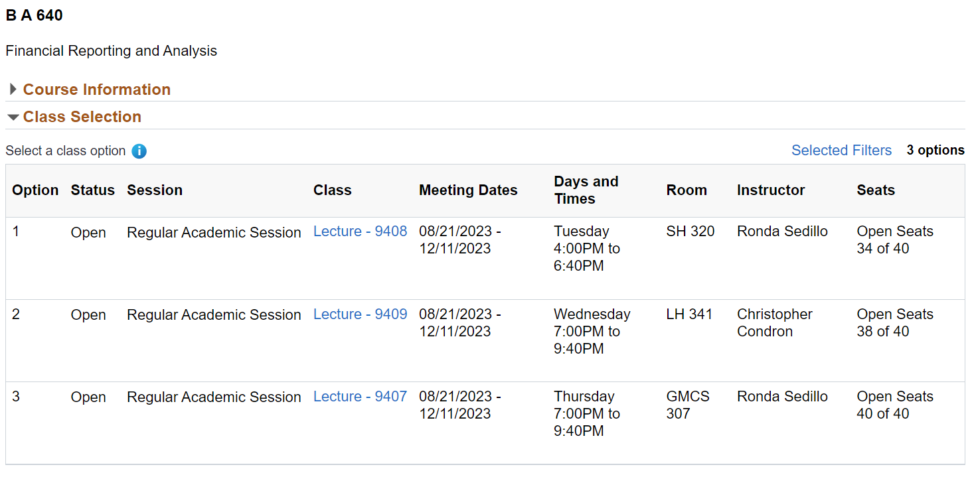
Understanding the Schedule

Slide 13
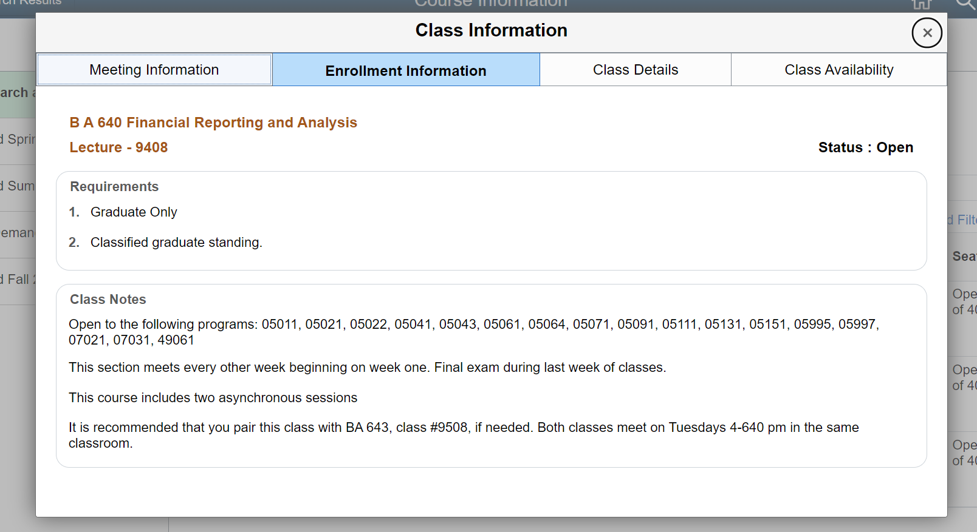

Slide 14
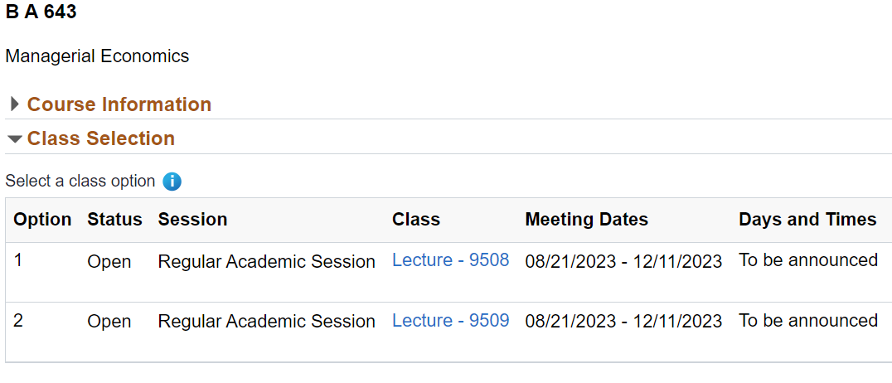
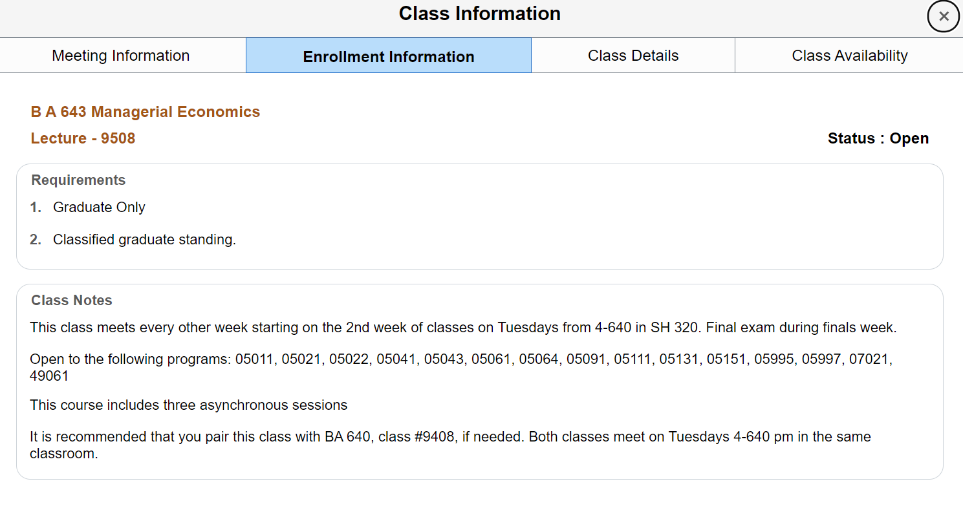

Slide 15
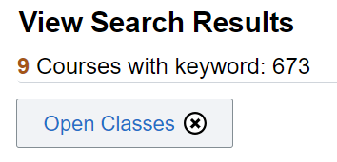
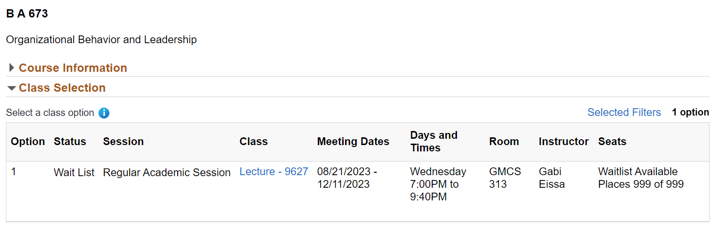
Waitlist

Slide 16
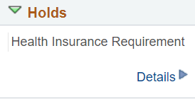
My.SDSU
Holds

Slide 17
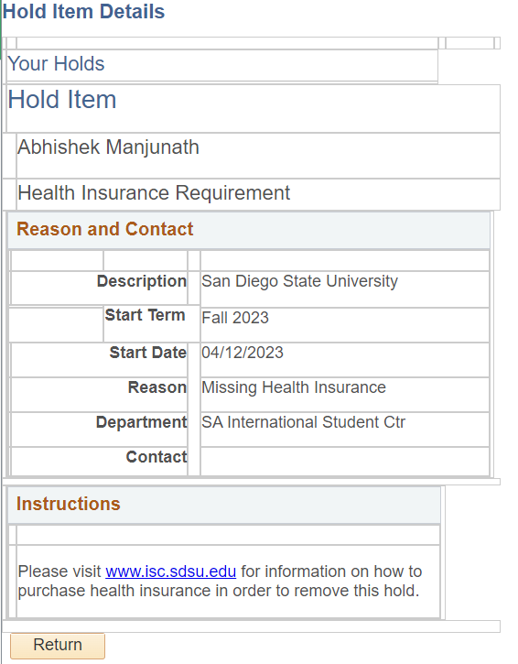
My.SDSU
Holds

Slide 18
Question #3 What other things do I need to know before I start?
Following your Program of Study
Orientation
Academic Calendar/Money Matters
Common Referrals

Slide 19
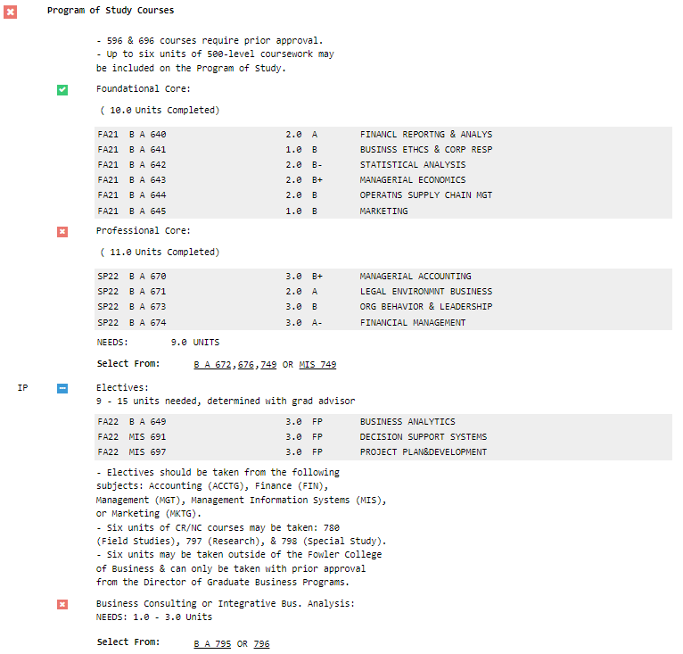
Your Degree Evaluation
AKA Degree Audit (Report)
AKA Degree Completion Plan
User your email w/o @sdsu.edu
Also, there is a section displaying your GPA and when/how to Advance to Candidacy among other useful info!

Slide 20
Orientation
Friday, August 18
5:30pm to 8:00pm
Saturday, August 19
9:00am to 12:00pm
(8:30 check-in)

Slide 21
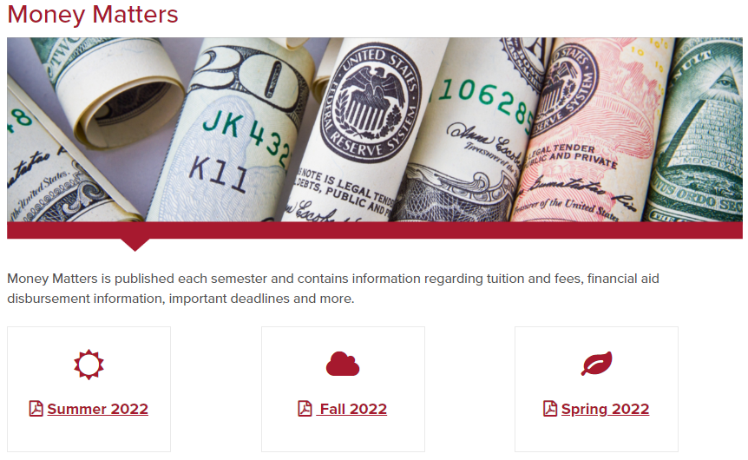
Academic Calendar Money Matters
Calendar found on Registrar’s website
registrar.sdsu.edu
Money Matters found on Student Account Services website
bfa.sdsu.edu/financial/student

Slide 22
Common Referrals
Student Account Services | Student Services West 2536 | bfa.sdsu.edu/financial/student/contact
Veterans Center | SSW1661 | 619-594-5813 | veterans@sdsu.edu
International Student Center | International Affairs Complex | 619-594-1982 | iscreception@sdsu.edu
Registrar | SSW 1551 |  | registrar@sdsu.edu
SDSU ID | SSW 2620 bfa.sdsu.edu/financial/student/sdsucard/get-a-card |  | sdsucard@sdsu.edu
Parking | bfa.sdsu.edu/campus/parkingtrans/parkingportal | 619 594-6671 | parking@sdsu.edu
?

