Slide 1
Assurance of Learning
MBA Experience

Slide 2
Assessment of Learning
Assessment of Experience
Assessment of Market Conditions and Alumni/Employer Feedback
MBA Experience

Slide 3
Case Analysis
Student Survey
Research
Strategy Course, Orientation and Workshops

Slide 4
Which of the following are MBA SLOs?
Demonstrate an expertise in a functional business area
Analyze the impact that environmental factors have on the functional areas of organizations and organizational activities.
Create a plan to become wealthy
Analyze the job market and develop a plan to land a first job or achieve a promotion with a current employer

Slide 5
Which of the following are MBA Program LOs?
Demonstrate an expertise in a functional business area
Analyze the impact that environmental factors have on the functional areas of organizations and organizational activities.
Create a plan to become wealthy
Analyze the job market and develop a plan to land a first job or achieve a promotion with a current employer

Slide 6
Which of the following are MBA Program LOs?
Analyze a business problem in new and unfamiliar circumstances through the integration of relevant disciplines.
Formulate strategies to solve business problems and pursue opportunities.
Make professional oral presentations
Use high-performance management behaviors to lead a team task that results in effective team performance

Slide 7
Which of the following are MBA SLOs?
Analyze a business problem in new and unfamiliar circumstances through the integration of relevant disciplines.
Formulate strategies to solve business problems and pursue opportunities.
Make professional oral presentations
Use high-performance management behaviors to lead a team task that results in effective team performance

Slide 8
Develop the solid foundation in theoretical concepts and managerial skills needed to lead business organizations.
SLO #1.1: Apply concepts and decision models in financial accounting, statistics, organizational behavior, finance, economics, marketing, and operations management to make business decisions.

Slide 9
Develop an awareness of environments in which managers make and implement ethical or global business decisions.
SLO #2.1: Identify and critically analyze salient responsibilities of organizations to all stakeholders.
SLO #2.2: Analyze the impact that environmental factors have on the functional areas of organizations and organizational activities.
SLO #2.3: Evaluate the impact that changes in the environment have on the business climate.
*(Environmental factors: economic, political/legal, social/cultural, demographic, technological, ecological)

Slide 10
Acquire the capacity to formulate and communicate strategies to solve business problems and pursue opportunities.
SLO #3.1: Analyze a business problem in new and unfamiliar circumstances through the integration of relevant disciplines.
SLO #3.2: Formulate strategies to solve business problems and pursue opportunities.
SLO #3.3: Make professional oral presentations.
SLO #3.4: Write clear and effective formal reports.

Slide 11
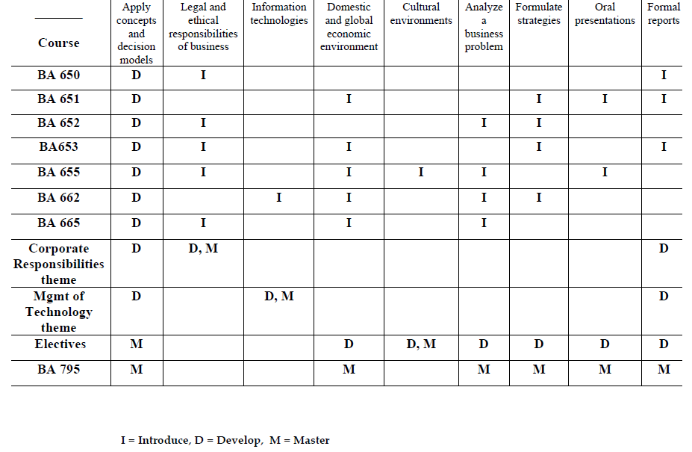

Slide 12
Learning Outcomes for MBAs
Have some important SLOs been overlooked?

Slide 13
Learning Outcomes for MBAs
Leadership and Challenges of Implementation
Mobilize others, interpersonal influence
Teamwork: coordination, cooperation
Power and Politics: conflicting agendas, diverse positions, competing points of view
SLO #3.5: Collectively frame problems, assign and complete tasks and develop (and implement) solutions
SLO #3.6: Use high-performance management behaviors to lead a team task that results in effective team performance.

Slide 14
Learning Outcomes for MBAs
Creative and Innovative Thinking
Ambiguity
Anticipation: knowing where to look for data
Synthesize
Understand the Limits of Markets and Models
Risk
Restraint
Regulation

Slide 15
Assessment Version 1.0
Assess foundation in theoretical concepts and managerial skills
Asked individual faculty
Identify examples of learning related to the different goals across course content
Evaluate those activities and provide analysis regarding learning
Assess awareness of environments in which managers make decisions
Asked a group of students to develop
a portfolio
Identify examples of learning related to the different goals across all course content
Graduate committee evaluated those activities and provided analysis regarding learning
Assess capacity to formulate and communicate strategies to solve business problems
Evaluated BA 795 projects

Slide 16
Assessment Version 1.0
Assess foundation in theoretical concepts and managerial skills
Asked individual faculty
Identify examples of learning related to the different goals across course content
Evaluate those activities and provide analysis regarding learning
Assess awareness of environments in which managers make decisions
Asked a group of students to develop
a portfolio
Identify examples of learning related to the different goals across all course content
Graduate committee evaluated those activities and provided analysis regarding learning
Assess capacity to formulate and communicate strategies to solve business problems
Evaluated BA 795 projects

Slide 17
Assessment Version 2.0
Assess foundation in theoretical concepts and managerial skills
Administer a multiple choice exam
Assess awareness of environments in which managers make decisions and capacity to formulate and communicate strategies to solve business problems
Evaluate BA 795 individual performance
Individual client analysis
In class case
Presentation

Slide 18
Assessment Version 2.0
What should the standard be for “meets expectations” on the assessment test on foundation in theoretical concepts and managerial skills?

Slide 19
Assessment Informs Curriculum and Pedagogy
Most student meet expectations in terms of their foundation in theoretical concepts and managerial skills needed to lead business and ability formulate and communicate strategies to solve business problems but there is significant forgetting toward the end of the program and the ability to integrate across discipline could be improved
Student oral communication meet expectations however the presentation “flow” need improvement (need work on transitions, timing coordination) and international /ESL students could improve confidence and clarity
Strategy course to integrate and review material in the middle of the program
Review material at the beginning of 795
Presentation workshop
Results
Closing-the-loop

Slide 20
Assessment: Indirect Evidence

Slide 21
Indirect evidence
MBA Exit Surveys
Spring and Fall 2010 graduates
150 responses

Slide 22
Identify and critically analyze salient legal and ethical responsibilities of business issues
70%
14%

Slide 23
Analyze impact that information technologies have on the functional areas of organizations
73%
12%

Slide 24
Evaluate impact that changes in the domestic & global economic environment have on the business climate
75%
14%

Slide 25
Identify similarities & differences among cultural environments that impact organizational activities
74%
13%

Slide 26
Analyze a business problem in new and unfamiliar circumstances through integration of relevant disciplines
85%
6%

Slide 27
Formulate strategies to solve business problems and pursue opportunities
87%
7%

Slide 28
Experience Assessment

Slide 29
Overall, I am satisfied with the quality of my education
83%
9%

Slide 30
My career opportunities will significantly increase as a direct result of my degree from SDSU
69%
13%

Slide 31
My experiences with SDSU faculty were positive
85%
7%

Slide 32
Professors use course material that is appropriately current
87%
5%

Slide 33
Professors use course material that is relevant
87%
5%

Slide 34
Professors use course material that is challenging
78%
9%

Slide 35
Group work is used effectively
73%
14%

Slide 36
Assessment Informs our Understanding of the MBA Experience
Our MBAs
Our Program
Meet Expectations

Slide 37
External Assessment

Slide 38
BA 795 team
International business specialization
Short-term study abroad experience
Language requirement

Slide 39
Can we exceed expectations?
Innovation
Pedagogy
Course Design
Modular structure
Curriculum
Competencies
Leadership
Team effectiveness

Slide 40
Outcomes for the MBA Experience?
Leadership and Challenges of Implementation
Mobilize others, interpersonal influence
Teamwork: coordination, cooperation
Power and Politics: conflicting agendas, diverse positions, competing points of view
Creative and Innovative Thinking
Ambiguity
Anticipation: knowing where to look for data
Synthesize
Understand the Limits of Markets and Models
Risk
Restraint
Regulation
New topics in the business environment

